Slide 2
HELSINKI AIRPORT
Personel 650.
Overall staff at the airport area is more than 20 000
There are over 16 million passengers annually
It has estimated that total flow of people in the airport is approximately 50 000 per day
Fenced area is total of 18 square kilometers
Notes:
2

Slide 3
FIRE FIGHTERS
36 highly trained and experienced professíonals
Minimum requirement for airport fire department is that one does have to have at least 10 years of experience and a fire fighters degree with Emergency Medical Technician (EMT) degree
At the moment there are six fire fighters with higher medical degree (paramedic)
Every fire fighter has passed few special cources for airport fire fighting

Slide 4
SOME FACTS
About 1000 incidents or securing task annually
42 000 liters of water stand by
Charge capability 20 000 litres/min
3 Fire Stations
4 Crash and 1 multi task vehicles
1 mobile incident command unit
1 All terrain vehicle

Slide 5
BATTALION CHIEF’S COMMAND VEHICLE

Slide 6
A VIEW FROM INSIDE

Slide 7
EMT ENGINE CO

Slide 8
CRASH TRUCK

Slide 9
ALARMS ANNUALY
Approximately 100 fire alarms per year mostly caused by mishandled repairments or cooking
Medical tasks well over 600
ICAO local stand by’s 20 to 30
Hazardious materials 100 to 150
Rescuing for the elevators 50
Total is normally well over 1000 annual missions
Notes:
9

Slide 10
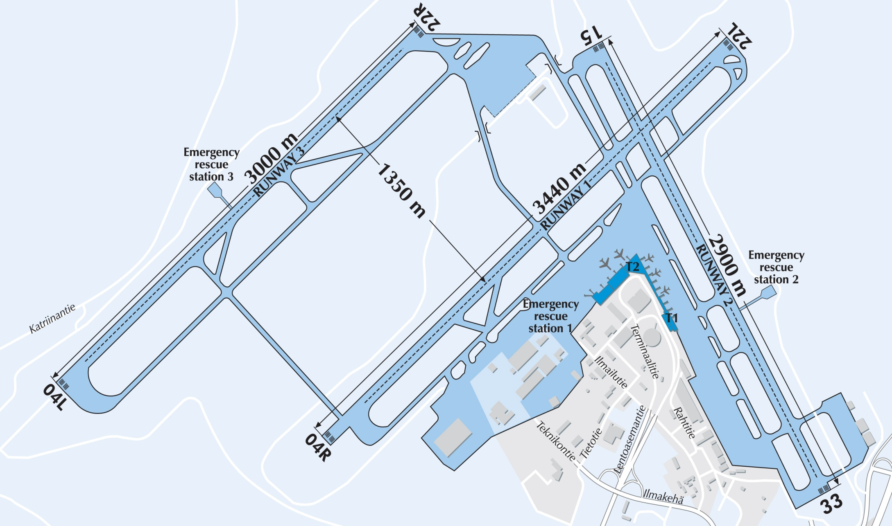
FIRE STATIONS AT THE AIRPORT AREA
Fire Station

Slide 11
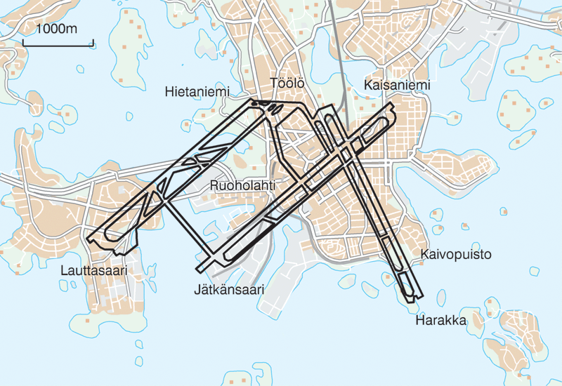
AIRFIELD VERSUS THE CITY
Notes:
11

Slide 12
FUTURE CHALLENGES for FD
New underground Railway to the Airport
Expansion and development of the Airport 2020
- new terminals
- Changes in airfield area
Increase of the passenger volyme 20 millions by year 2020
Economy
Notes:
12

Slide 13
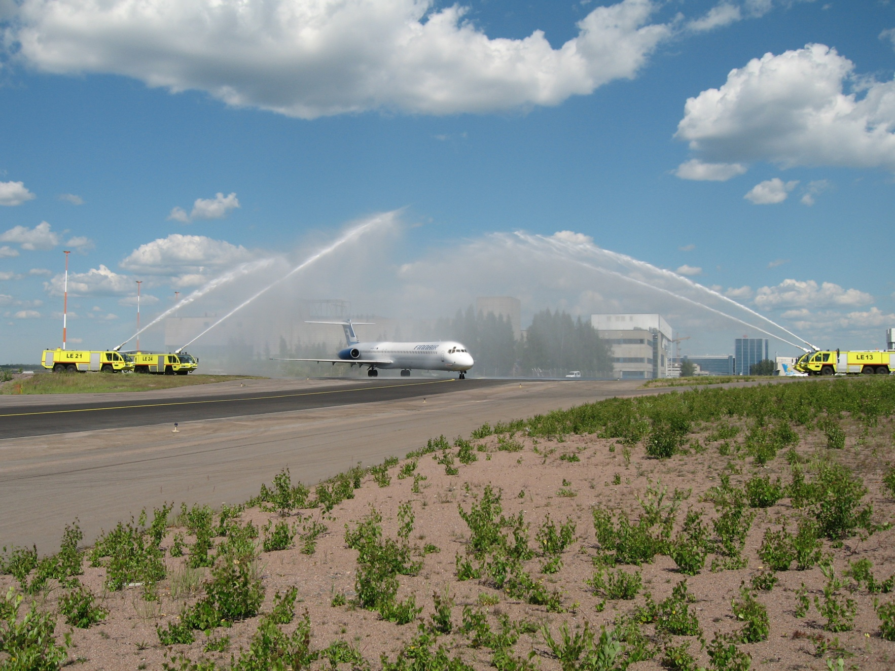
THANK YOU!
Notes:
DC-9 viimeinen lento 3.7.2006

Slide 14
Any questions?

